Slide 1
ISM 6136
Data Mining
Dr. Tim Smith

Slide 2
Classification Modeling using k-NN

Slide 3
Learning outcomes :
Understand how k-NN classifies new data.
Understand how to implement a k-NN classifier using python.
Understand one of the big issues k-NN (and other modeling techniques) can have
This problem is revealed later in the slides and will be discussed/explored.

Slide 4
K-NN
There are many ways we could model a classifier.
Today we will create our first classifier using k-NN (k-nearest neighbors)
Don’t confuse this with K-means clustering – which represents an unsupervised algorithm, mainly used for clustering.
High level overview….
k-NN looks at the distance between a new point and those around it. Based on knowing the classification of its neighbors, we can predict the classification of this new point.

Slide 5
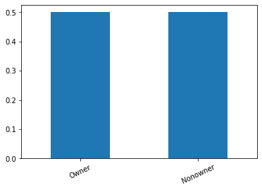
Classification Modeling Example
Income | Lot_Size | Ownership
60 | 18.4 | Owner
85.5 | 16.8 | Owner
64.8 | 21.6 | Owner
61.5 | 20.8 | Owner
87 | 23.6 | Owner
110.1 | 19.2 | Owner
108 | 17.6 | Owner
82.8 | 22.4 | Owner
69 | 20 | Owner
93 | 20.8 | Owner
51 | 22 | Owner
81 | 20 | Owner
75 | 19.6 | Nonowner
52.8 | 20.8 | Nonowner
64.8 | 17.2 | Nonowner
43.2 | 20.4 | Nonowner
84 | 17.6 | Nonowner
49.2 | 17.6 | Nonowner
59.4 | 16 | Nonowner
66 | 18.4 | Nonowner
47.4 | 16.4 | Nonowner
33 | 18.8 | Nonowner
51 | 14 | Nonowner
63 | 14.8 | Nonowner
By looking at our count distribution, we can see that we have excellent representation of each category
NOTE: What does and “acceptable” distribution look like? This is a judgment call on your part. If there is one class with little representation, the predictive power of any model you fit will be lower than if we have a more even split.

Slide 6
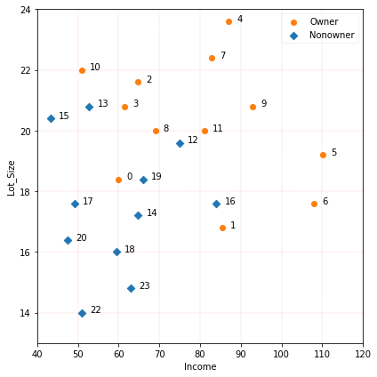
Classification Modeling Example
Visualize our data…
Question:
What model can we develop that will allow us to predict ownership based on having Income and LotSize?

Slide 7
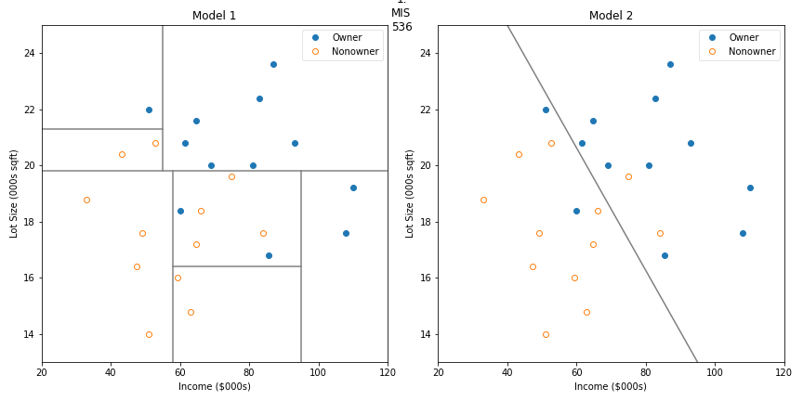
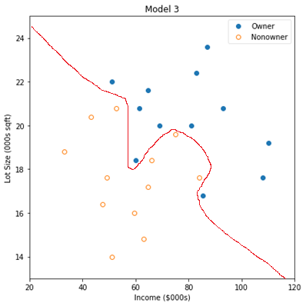
Classification Modeling Example
Income | Lot_Size | Ownership
60 | 18.4 | Owner
85.5 | 16.8 | Owner
64.8 | 21.6 | Owner
61.5 | 20.8 | Owner
87 | 23.6 | Owner
110.1 | 19.2 | Owner
108 | 17.6 | Owner
82.8 | 22.4 | Owner
69 | 20 | Owner
93 | 20.8 | Owner
51 | 22 | Owner
81 | 20 | Owner
75 | 19.6 | Nonowner
52.8 | 20.8 | Nonowner
64.8 | 17.2 | Nonowner
43.2 | 20.4 | Nonowner
84 | 17.6 | Nonowner
49.2 | 17.6 | Nonowner
59.4 | 16 | Nonowner
66 | 18.4 | Nonowner
47.4 | 16.4 | Nonowner
33 | 18.8 | Nonowner
51 | 14 | Nonowner
63 | 14.8 | Nonowner
In the first class, we contemplated a linear classifier and a tree classifier and some seemingly random line that we drew (more on these later) .

Slide 8
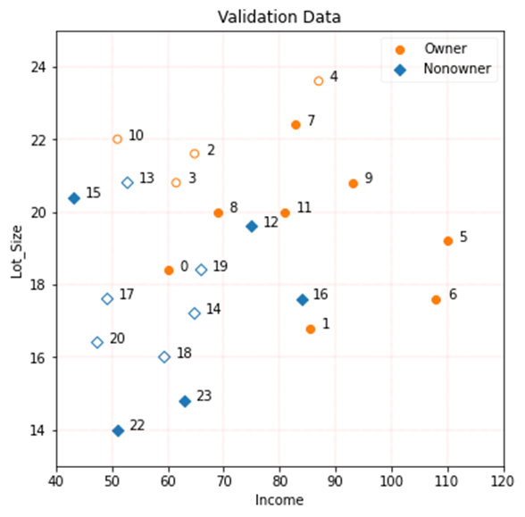
k-NN
Now here’s another way...
Income | Lot_Size | Ownership
60 | 18.4 | Owner
85.5 | 16.8 | Owner
64.8 | 21.6 | Owner
61.5 | 20.8 | Owner
87 | 23.6 | Owner
110.1 | 19.2 | Owner
108 | 17.6 | Owner
82.8 | 22.4 | Owner
69 | 20 | Owner
93 | 20.8 | Owner
51 | 22 | Owner
81 | 20 | Owner
75 | 19.6 | Nonowner
52.8 | 20.8 | Nonowner
64.8 | 17.2 | Nonowner
43.2 | 20.4 | Nonowner
84 | 17.6 | Nonowner
49.2 | 17.6 | Nonowner
59.4 | 16 | Nonowner
66 | 18.4 | Nonowner
47.4 | 16.4 | Nonowner
33 | 18.8 | Nonowner
51 | 14 | Nonowner
63 | 14.8 | Nonowner
Look at each data point, then choose k neighbors (where k is some integer between 1 and the total number of observations).
Based on these identified k-nearest neighbors, look at the actual category for each, and then choose the major category. This is your prediction for the given point.
There is an algorithm for that!
K-Nearest Neighbors

Slide 9
k-NN
Set k
Income | Lot_Size | Ownership
60 | 18.4 | Owner
85.5 | 16.8 | Owner
64.8 | 21.6 | Owner
61.5 | 20.8 | Owner
87 | 23.6 | Owner
110.1 | 19.2 | Owner
108 | 17.6 | Owner
82.8 | 22.4 | Owner
69 | 20 | Owner
93 | 20.8 | Owner
51 | 22 | Owner
81 | 20 | Owner
75 | 19.6 | Nonowner
52.8 | 20.8 | Nonowner
64.8 | 17.2 | Nonowner
43.2 | 20.4 | Nonowner
84 | 17.6 | Nonowner
49.2 | 17.6 | Nonowner
59.4 | 16 | Nonowner
66 | 18.4 | Nonowner
47.4 | 16.4 | Nonowner
33 | 18.8 | Nonowner
51 | 14 | Nonowner
63 | 14.8 | Nonowner
Let’s look at k=3, therefore we are testing a 3-nn model.
Let’s look at observation #9.
We see that of the three nearest neighbors, all are “Owners”. Therefore, we’d predict that this is an owner. Correct!

Slide 10
k-NN
Now here’s another way...
Income | Lot_Size | Ownership
60 | 18.4 | Owner
85.5 | 16.8 | Owner
64.8 | 21.6 | Owner
61.5 | 20.8 | Owner
87 | 23.6 | Owner
110.1 | 19.2 | Owner
108 | 17.6 | Owner
82.8 | 22.4 | Owner
69 | 20 | Owner
93 | 20.8 | Owner
51 | 22 | Owner
81 | 20 | Owner
75 | 19.6 | Nonowner
52.8 | 20.8 | Nonowner
64.8 | 17.2 | Nonowner
43.2 | 20.4 | Nonowner
84 | 17.6 | Nonowner
49.2 | 17.6 | Nonowner
59.4 | 16 | Nonowner
66 | 18.4 | Nonowner
47.4 | 16.4 | Nonowner
33 | 18.8 | Nonowner
51 | 14 | Nonowner
63 | 14.8 | Nonowner
Now, let’s look at observation #0.
We see that of the three nearest neighbors, all are “Nonowners”. Therefore, we’d predict that this is a nonowner. Incorrect ☹

Slide 11
k-NN
Income | Lot_Size | Ownership
60 | 18.4 | Owner
85.5 | 16.8 | Owner
64.8 | 21.6 | Owner
61.5 | 20.8 | Owner
87 | 23.6 | Owner
110.1 | 19.2 | Owner
108 | 17.6 | Owner
82.8 | 22.4 | Owner
69 | 20 | Owner
93 | 20.8 | Owner
51 | 22 | Owner
81 | 20 | Owner
75 | 19.6 | Nonowner
52.8 | 20.8 | Nonowner
64.8 | 17.2 | Nonowner
43.2 | 20.4 | Nonowner
84 | 17.6 | Nonowner
49.2 | 17.6 | Nonowner
59.4 | 16 | Nonowner
66 | 18.4 | Nonowner
47.4 | 16.4 | Nonowner
33 | 18.8 | Nonowner
51 | 14 | Nonowner
63 | 14.8 | Nonowner
We keep doing this for every value in the train data set.
After doing this, we calculated how well the given k value of 3 predicted outcomes by calculating the percentage of correct predictions.

Slide 12
k-NN
Income | Lot_Size | Ownership
60 | 18.4 | Owner
85.5 | 16.8 | Owner
64.8 | 21.6 | Owner
61.5 | 20.8 | Owner
87 | 23.6 | Owner
110.1 | 19.2 | Owner
108 | 17.6 | Owner
82.8 | 22.4 | Owner
69 | 20 | Owner
93 | 20.8 | Owner
51 | 22 | Owner
81 | 20 | Owner
75 | 19.6 | Nonowner
52.8 | 20.8 | Nonowner
64.8 | 17.2 | Nonowner
43.2 | 20.4 | Nonowner
84 | 17.6 | Nonowner
49.2 | 17.6 | Nonowner
59.4 | 16 | Nonowner
66 | 18.4 | Nonowner
47.4 | 16.4 | Nonowner
33 | 18.8 | Nonowner
51 | 14 | Nonowner
63 | 14.8 | Nonowner
Now, what about other possible values of k?
We can redo the NN procedure for any value of k (between 1 and n-1).
For instance, here we see k=3
NOTE: This is for illustration purposes…as you may notice, I haven’t put a circle around every value in our training set.
n is the number of observations (aka rows)

Slide 13
k-NN
If we keep repeat this process for all values from 1 to the number of observations, we determine a percentage accuracy for each value of k.
Income | Lot_Size | Ownership
60 | 18.4 | Owner
85.5 | 16.8 | Owner
64.8 | 21.6 | Owner
61.5 | 20.8 | Owner
87 | 23.6 | Owner
110.1 | 19.2 | Owner
108 | 17.6 | Owner
82.8 | 22.4 | Owner
69 | 20 | Owner
93 | 20.8 | Owner
51 | 22 | Owner
81 | 20 | Owner
75 | 19.6 | Nonowner
52.8 | 20.8 | Nonowner
64.8 | 17.2 | Nonowner
43.2 | 20.4 | Nonowner
84 | 17.6 | Nonowner
49.2 | 17.6 | Nonowner
59.4 | 16 | Nonowner
66 | 18.4 | Nonowner
47.4 | 16.4 | Nonowner
33 | 18.8 | Nonowner
51 | 14 | Nonowner
63 | 14.8 | Nonowner
k | Accuracy
1 | 0.7
2 | 0.8
3 | 0.9
4 | 0.7
5 | 0.9
6 | 0.9
7 | 0.9
8 | 0.9
9 | 0.8
10 | 0.8
11 | 0.9
12 | 0.4
13 | 0.4

Slide 14
Classification Modeling Example
k | Accuracy
1 | 0.7
2 | 0.8
3 | 0.9
4 | 0.7
5 | 0.9
6 | 0.9
7 | 0.9
8 | 0.9
9 | 0.8
10 | 0.8
11 | 0.9
12 | 0.4
13 | 0.4
Question: Based on this table, which is the “best” model?

Slide 15
Classification Modeling Example
k | Training Data | Validation Data
1 | 0.7 | ?
2 | 0.8 | ?
3 | 0.9 | ?
4 | 0.7 | ?
5 | 0.9 | ?
6 | 0.9 | ?
7 | 0.9 | ?
8 | 0.9 | ?
9 | 0.8 | ?
10 | 0.8 | ?
11 | 0.9 | ?
12 | 0.4 | ?
13 | 0.4 | ?
To best determine performance, we should test the model on unseen data… in this case, the data we set aside for validation.

Slide 16
Classification Modeling Example
k | Training Data | Validation Data
1 | 0.7 | 0.7
2 | 0.8 | 0.9
3 | 0.9 | 0.9
4 | 0.7 | 0.8
5 | 0.9 | 0.9
6 | 0.9 | 0.9
7 | 0.9 | 0.9
8 | 0.9 | 0.9
9 | 0.8 | 0.8
10 | 0.8 | 0.9
11 | 0.9 | 0.9
12 | 0.4 | 0.5
13 | 0.4 | 0.6
To best determine performance, we should test the model on unseen data… in this case, the data we set aside for validation.

Slide 17

How do we calculate distance?
Calculate the distance between observation 9 and observation 5.
(X₉, Y₉)
$$\sqrt{{\left(X_{9}−X_{5}\right)}^{2}+{\left(Y_{9}−Y_{5}\right)}^{2} }$$
(Y₉ – Y₅)
(X₉ – X₅)
(X₅, Y₅)
Note: Pythagorean Theorem also works to calculate distance in more the two dimensions.
$$\sqrt{{\left(X_{9}−X_{5}\right)}^{2}+{\left(Y_{9}−Y_{5}\right)}^{2}+{\left(Z_{9}−Z_{5}\right)}^{2} }$$

Slide 18
How do we calculate k-nearest?
Give the point of interest, the algorithm involves calculating the distance between this point and all other points in the data set (note: each “point” is an observation).
The result is then sorted ascending, and the k lowest values are taken.
For instance, if we are testing 2-NN, then
d2
d3
d4
d1
 | distance
d3 | 5.3
d2 | 5.9
d4 | 6.2
d1 | 7.0
2 nearest neighbors

Slide 19
Worked Example
Following along with the professor

Slide 20
One potential problem… Scale
Unless the two values are recorded using the same scale, I terms of distance, then one variable may “dominate” the other.
To help address this problem, it’s often advised to create a common scale across your variables.
There are three common methods to accomplish this.
Min-Max Normalization
Mean Normalization
Standardization

Slide 21



Scaling a variable
Min-Max normalization
Mean normalization
Standardization (Z-score Normalization)
✓
Use for k-NN

Slide 22
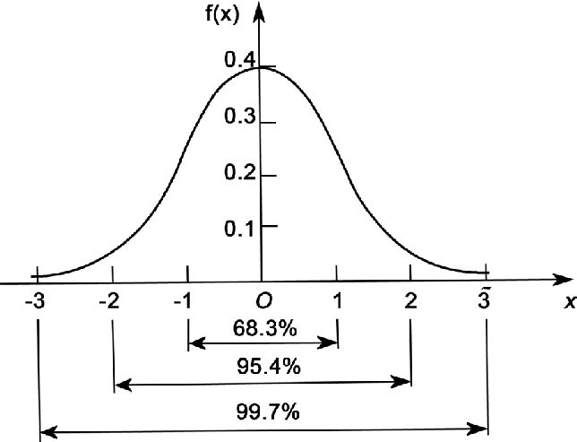
Scaling a variable
Standardization (Z-score Normalization)
mean
Standard Deviation

Slide 23
Scaling must be done after train-test split
If we scale before the split, then we have used test data to determine the mean and standard deviation – this is data leakage, and will lead to model overfitting.

Slide 24
K-NN Summary
Machine Learning algorithm
Focused on predicting outcomes
Doesn’t tell us anything about which factors are more Influential than others
Doesn’t require any assumptions around predictors.
Does require…
Rescaling all predictors to a common scale (normalization or standardization techniques)
Transforming categorical variable to dummy variable

Slide 25
Summary of steps
Step 1: Import the necessary Libraries
Step 2: Load and clean the dataset
This process varies by the problem context and actual data
Check column names
Check to see you have good representation of all the categories found in your target variable
Drop records with a significant number of missing values
Impute missing values
Identify and rebalance any significant data imbalances. <- this is what you’ll explore in assignment02 and discussion04.
Step 3: Split the data into training and test sets
70/30 split is commonly used (book used a 60/40 split, so that’s what I used in the sample solution)
Note: there is debate on what is an appropriate ratio is/ literature indicates a 70-75% allocation for training might be optimal.

Slide 26
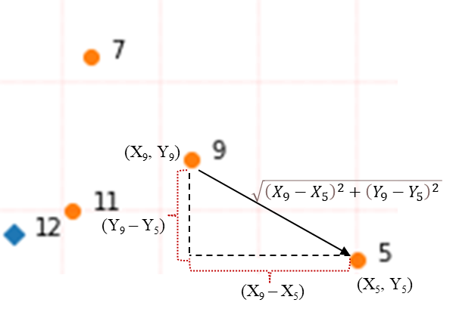
Summary of steps
Step 4: Standardize/Normalize the data scale of the predictors
Train(fit) your scaler on the training data
Apply the trained scaler on your training and validation dataset
Do not normalize/standardize the target variable.
Why standardize/normalize the predictors?
A scale indicates how something is measured
K-NN algorithm is based on the measurement of multidimensional distances
Normalizing/standardizing variables brings all measures into the same scale
Why train the scaler only on the training data?
We don’t want information leak from our training set to our validation/test set.
Remember: We’re trying to simulate ‘future’ data, data that we’ve not seen (as this will be the situation in production, where we won’t know the target variable.
Step 5: Train the Model for each value of k using transformed training set and assess performance on validation/test data.
As a general rule, train model using k values up to n^{1/2} (with large data sets this may take too long to process, so try a smaller set, and look at the trend in performance (step 6) for increasing k values)

Slide 27
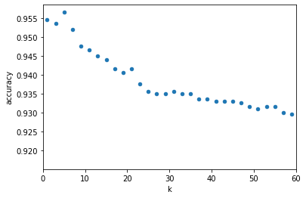
Summary of steps
Step 7: Evaluate the performance of your set of k values, select a k value the produces the best performance (for the given context).
Determine the most appropriate scoring measure(s) (you may need to consider more than one).
With many k values, you should visualize (or put into table form) the model score for variable values of k
Step 8: Deploy Model
Support a single decision or Integrate model into business process(es) for continuous prediction

Slide 28
Scoring Classification Models

Slide 29
Learning outcomes :
Review Accuracy, Recall, Precision and F1-Score
Look at PR Curver and AUC

Slide 30
Recall:
Accuracy:
TP / (TP+FN)
(TN+TP) / (TN+TP+FP+FN)
If a positive value is predicted, how many FN’s did it take? Recall is the ability of a classification model to identify all relevant instances
Precision:
F1 Score:
TP / (TP+FP)
(2*precision*recall) / (precision + recall)
When a positive value is predicted, how often is the prediction correct? In other words: How "precise" is the classifier when predicting positive instances?
A single metric that combines recall and precision using the harmonic mean

Slide 31
Key points: It’s about understanding and analyzing trade-offs
It’s natural to initial focus on maximizing accuracy (or minimizing error rate).
In an ideal world we would be able to produce 100% accurate models, but this is rarely possible in real world situations.
Since we generally need to accept some error rate, we need to evaluate the cost of such errors:
If the cost of a FN is greater than a FP, we will want to focus more on optimize recall.
If the cost of an FP is greater than a FN, we will want to focus on optimizing recall.
NOTE: Later we will see FBeta, which can further help us in such situations.

Slide 32
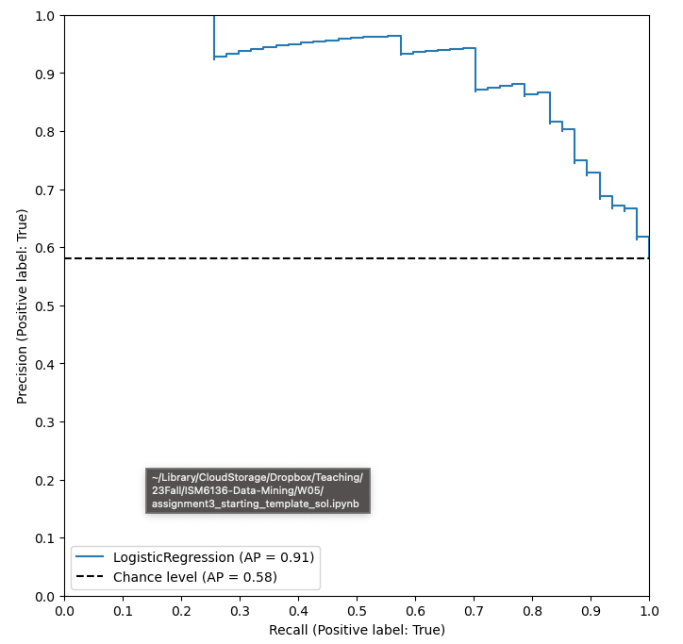
Precision-Recall Curves
The precision-recall curve shows the tradeoff between precision and recall for different threshold. A high area under the curve represents both high recall and high precision, where high precision relates to a low false positive rate, and high recall relates to a low false negative rate.

Slide 33
Happy Learning!

